Slide 1

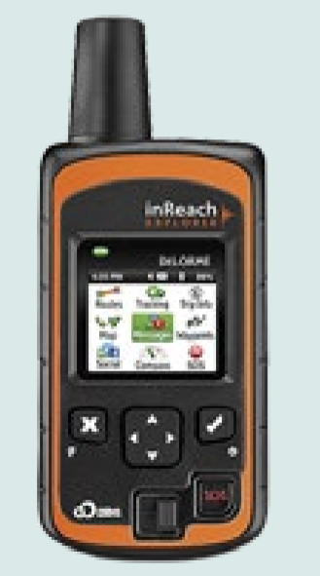
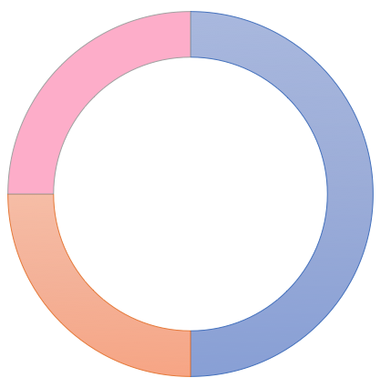
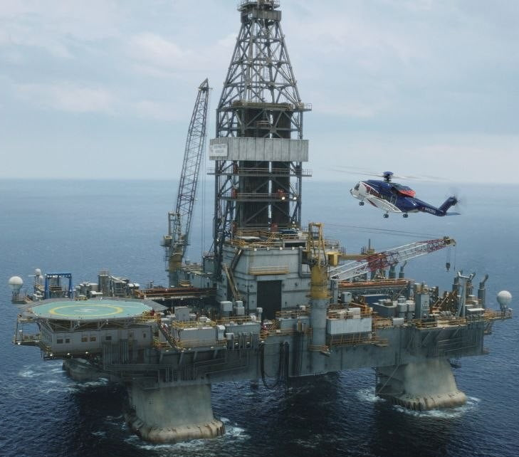
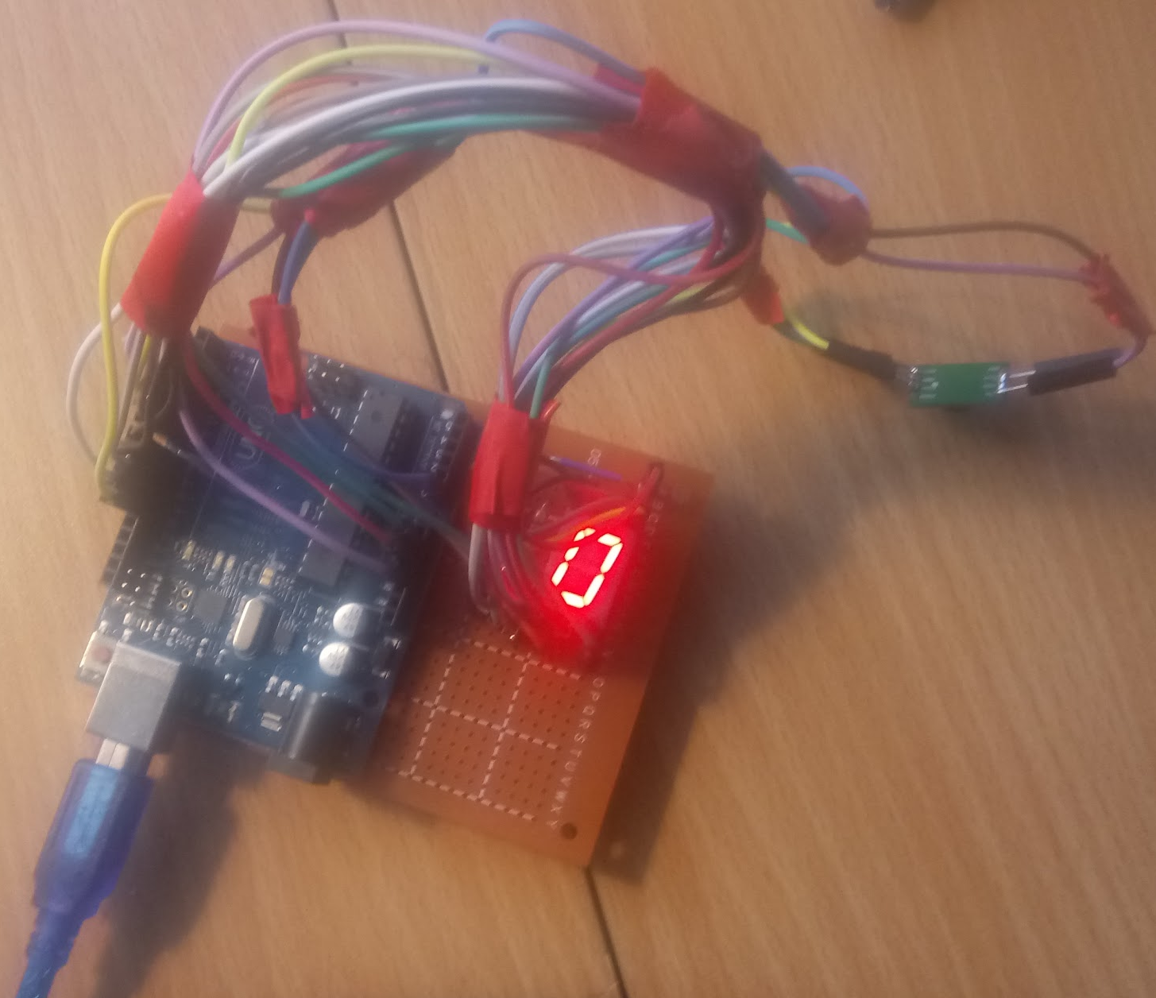
Asset Tracking on an Offshore Oil Rig
During the Deepwater Horizon oil spill disaster, authorities were searching for the lost employees for 3 days.
Report
Oil companies need a tracking and monitoring system for its employees while they are onsite to protect them.
Context
System Architecture
Our project investigates methods and tools that are used to track employees and assets.
Approach
Our project investigates methods and tools that are used to track employees and assets.
Prototype
Scope and Impact
A successful implementation of this project will improve the safety of all those working on an oil rig.
In the case of an emergency the system would notify the employees of the crisis and notify rescuers where the employees are.
Alisha Boniface, Franklin Wilson, Dillon McGrath, Jordan Schaeffer, Robert Whittaker, Woojin Ra

